Slide 1
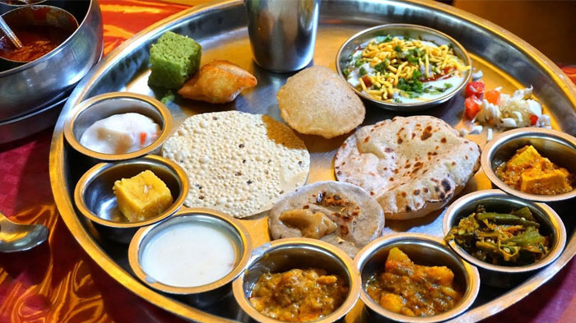
Coursera Capstone
IBM Applied Data Science Capstone
Opening an Indian Restaurant in New York
By: Pradeep Mallampalli
December 2020

Slide 2
Business Problem
The objective of this Capstone project is to analyze and select the best locations in the city of New York to open a new Indian restaurant. Using Data Science methodology and instruments such as Data Analysis and Visualization, this project aims to provide solutions to answer the business question: Where in the city of New York, should the investor open a Indian Restaurant?

Slide 3
Data
New York City data containing the neighborhoods and boroughs.
Latitude and longitude coordinates of those neighborhoods. This is required to plot the map and get the venue data.
Venue data, particularly data related to restaurants. We are going to use this data to perform further analysis of the neighborhoods.
New York City data containing the neighborhoods and boroughs will be obtained from the open data source: https://cocl.us/new_york_dataset . After it, we will get the geographical coordinates of the neighborhoods (latitude and longitude) using Python Geocoder package.
We will use Foursquare API to get the venue data for the neighborhoods defined at the previous step. Foursquare has one of the largest databases of 105+ million places and over 125,000 developers use this application

Slide 4
Methodology
Collect the data from https://cocl.us/new_york_dataset Clean and process the data into a dataframe
Using FourSquare , locate all venues and then filter by Indian restaurants. Ratings, tips, and likes by users will be counted and added to the dataframe
Sort the data based on rankings.
Visually assess the data be will be using graphing from Python
libraries.

Slide 5
Results
Manhattan has the highest number of Indian restaurants comparing to the other boroughs.
Manhattan has the highest average rating for Indian Restaurants.
Two neighborhoods with the highest average rating for Indian Restaurants are Cobble Hill and North Side (both located in Brooklyn).

Slide 6
Discussion Section
Based on the results of our analysis, Manhattan and Brooklyn are the best locations for Indian cuisine in NYC.
Brooklyn is a more promising place to open a new Indian restaurant.
I would state that Manhattan and Brooklyn are the best locations for Indian cuisine in NYC

Slide 7
Conclusion
Manhattan and Staten Island have the best rated Indian restaurants on average.
Staten Island and Bronx have the least amount of Indian restaurants per borough.
However, of note, Manhattan has the highest number of Indian Restaurants in all of NY.
Based on the above information, I would state that Manhattan and Brooklyn are the best locations for Indian cuisine in NYC. To have the best shot of success, I would open a Indian restaurant in Brooklyn. Brooklyn has multiple neighborhoods with average ratings exceeding 8.0 on a scale of 1.0 to 10.0 and has less amount of Indian restaurants than Manhattan, making competition easier.

Slide 8

ThE ENd
This Photo by Unknown Author is licensed under CC BY-SA

